Slide 1






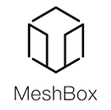
Enterprise Blockchain Developers (Intermediate)
In support of
Powered By

Slide 2
Outline
DataBase Design
© 2017-2020 SmartMesh Foundation Pte. Ltd. | MeshBox Foundation Pte. Ltd.

Slide 3
IPFS
What is IPFS
IPFS is a distributed system for storing and accessing files, websites, applications, and data.
There are three fundamental principles to understanding IPFS:
1. Unique identification via content addressing
For Instance: /ipfs/QmXoypizjW3WknFiJnKLwHCnL72vedxjQkDDP1mXWo6uco/wiki/Aardvark.html
Web identify content by where it's located
IPFS uses content addressing to identify content by what's in it.
The hash is unique to the content that it came from, even though it may look short compared to the original content

Slide 4
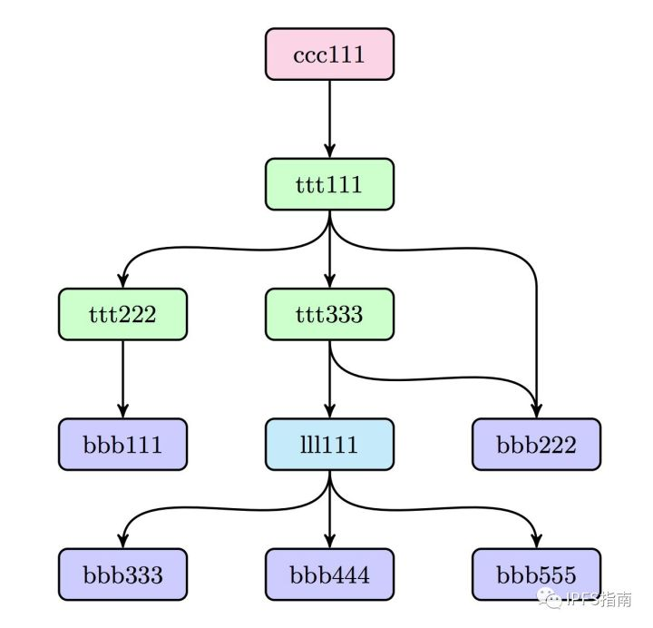
IPFS
Content linking via directed acyclic graphs (DAGs)

Slide 5
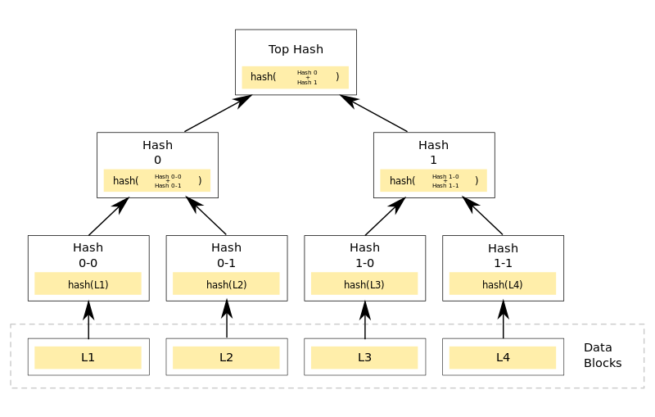
IPFS
Content linking via directed acyclic graphs (DAGs) Merkle DAG
when doing IPFS ADD
Demo: https://dag.ipfs.io/

Slide 6
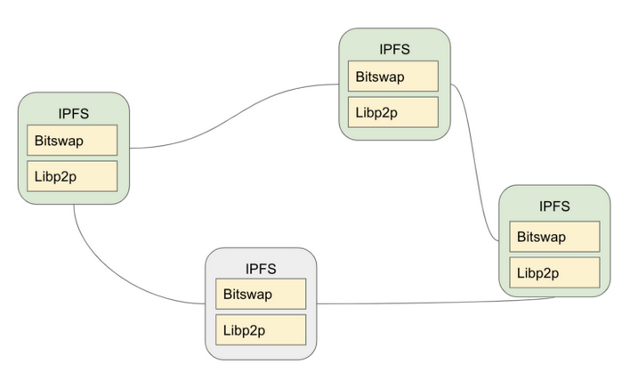
IPFS
Content discovery via distributed hash tables (DHTs)
To find which peers are hosting the content you're after (discovery), IPFS uses a distributed hash table, or DHT
What makes libp2p especially useful for peer to peer connections is connection multiplexing
Bitswap allows you to connect to the peer or peers that have the content you want, send them your wantlist and have them send you the blocks you requested.

Slide 7
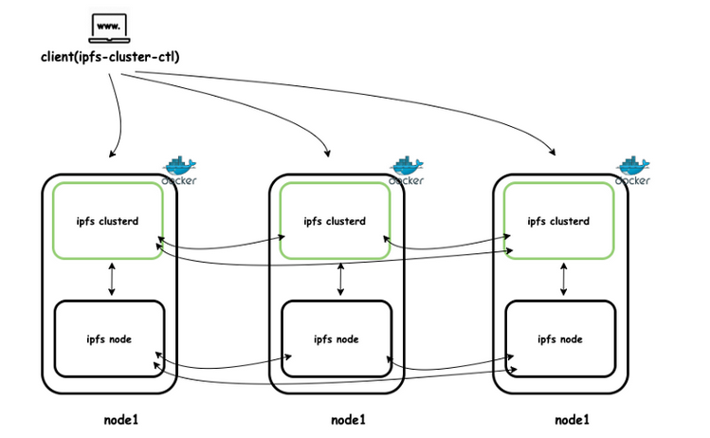
IPFS Cluster
IPFS Cluster:
Automatic replication and pinning across your IPFS network

Slide 8
IPFS Cluster
IPFS Cluster:
Automatic replication and pinning across your IPFS network

Slide 9
IPFS Cluster
IPFS Cluster
how to build your CND using IPFS cluster?
Step 1:
domain name or a subdomain
Step 2:
a minimum of two servers in different regions. The servers can be dedicated or virtual (IPFS Cluster)
Step 3:
geoDNS tool. With it, a user sending a request to the domain will be directed to the nearest server

Slide 10
IPFS Cluster
IPFS Cluster
how to build your CND using IPFS cluster?
Here's how geoDNS works:
It gets the client's IP (if they sent the DNS request) or the IP of the recursive DNS server that is used for processing the request. Generally speaking, such recursive servers are usually the DNSs of the Internet providers.
By the client's IP it identifies their country or region. This operation requires the use of GeoIP database, which are available in no short supply. There are even decent free options.
Depending on the client's location, geoDNS returns him the IP address of the closest CDN server.

Slide 11
IPFS Cluster
IPFS Cluster
how to build your CND using IPFS cluster?
Step 3.1:
Install IPFS Cluster
https://medium.com/rahasak/ipfs-cluster-with-docker-db2ec20a6cc1
(Terraform and Ansible to auto install and manage the cluster)

Slide 12
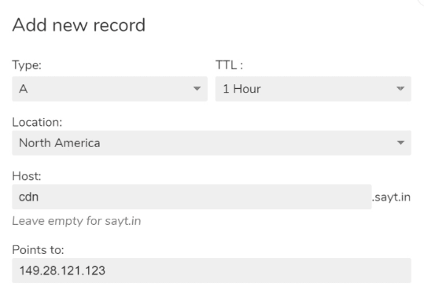
IPFS Cluster
IPFS Cluster
how to build your CND using IPFS cluster?
Step 3.2:
СlouDNS,Zilore, Amazon Route 53, Cloudflare

Slide 13
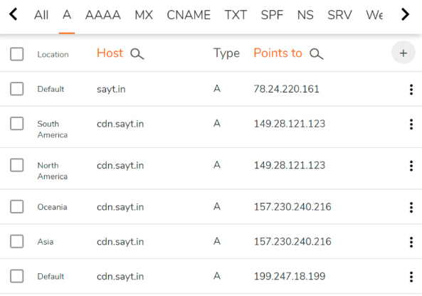
IPFS Cluster
IPFS Cluster
how to build your CND using IPFS cluster?
Step 3.1:
СlouDNS,Zilore, Amazon Route 53, Cloudflare

Slide 14
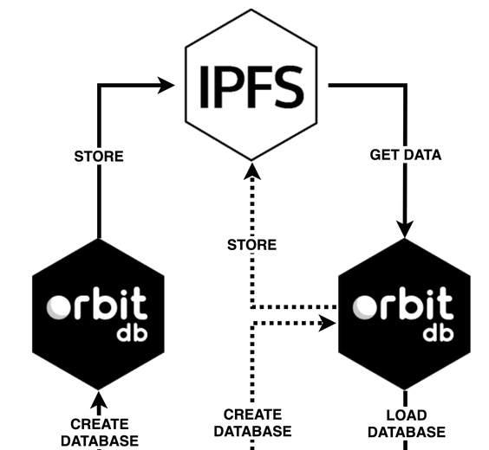
OrbitDB
OrbitDB is a serverless, distributed, peer-to-peer database. OrbitDB uses IPFS as its data storage and IPFS Pubsub to automatically sync databases with peers.

Slide 15
OrbitDB
Data Type:
Key-Value
Log (append-only log)
Feed (same as log database but entries can be removed)
Documents (store indexed JSON documents)
Counters
https://github.com/orbitdb/orbit-db/blob/master/API.md#orbitdbkeyvaluenameaddress
(Code Explain)
OrbitDB (Code Demo)

Slide 16
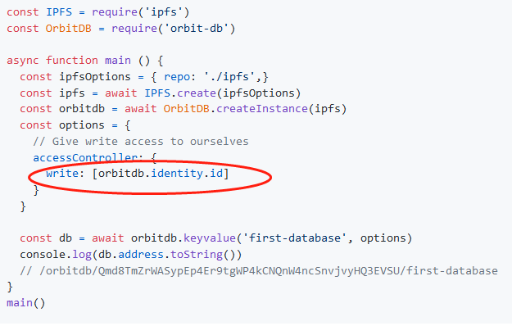
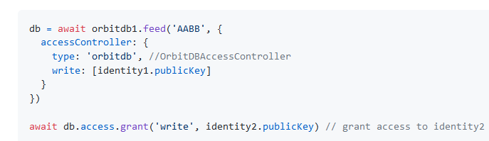
OrbitDB
Features:
1 Identity:
Add Access after db creation

Slide 17
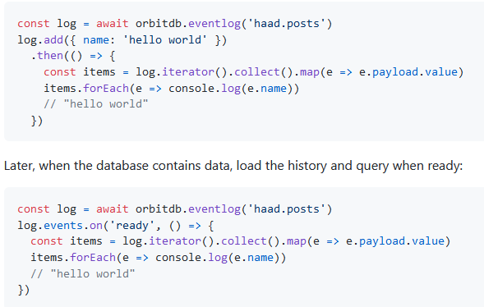
OrbitDB
Features:
2 Event: event and feed

Slide 18
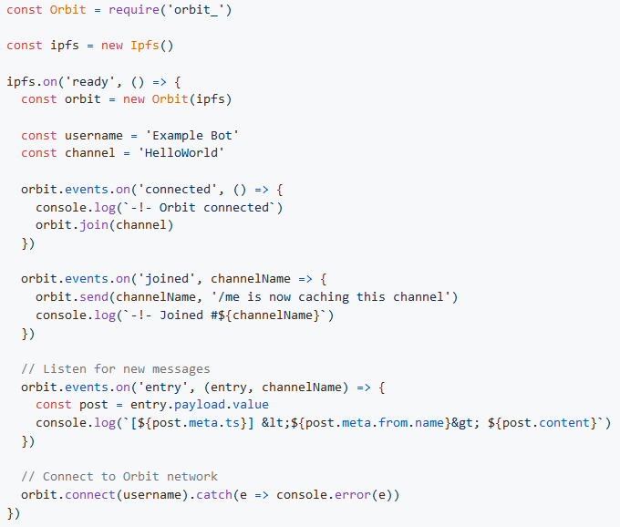
Orbit Core
Orbit is a serverless, distributed, p2p communication library and protocol that enables feed-based information sharing2 Event: event and feed
https://github.com/orbitdb/orbit-core

Slide 19
Cases
Chat / Social Media
Marketplace
File Store
CDN
Others

Slide 20

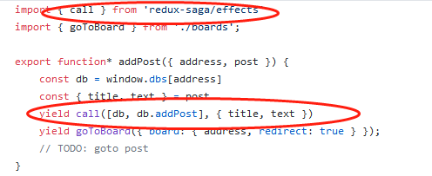
Cases
1 IPFS Board (OrbitDB)
https://github.com/fazo96/ipfs-boards/tree/master/src
BoardStore removed

Slide 21
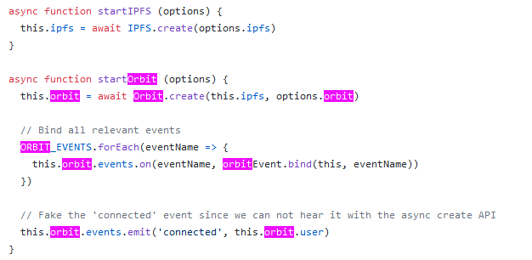
Cases
Orbit Chat (Orbit Core)
https://github.com/orbitdb/orbit-web/blob/d1079653976495e5ae749f1410e11e6af980a6ec/src/workers/network.worker.js

Slide 22
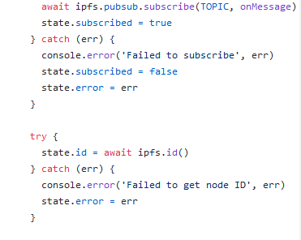
Cases
ipfs-pubsub-chat (pubsub)
https://github.com/tableflip/ipfs-pubsub-chat-example

Slide 23
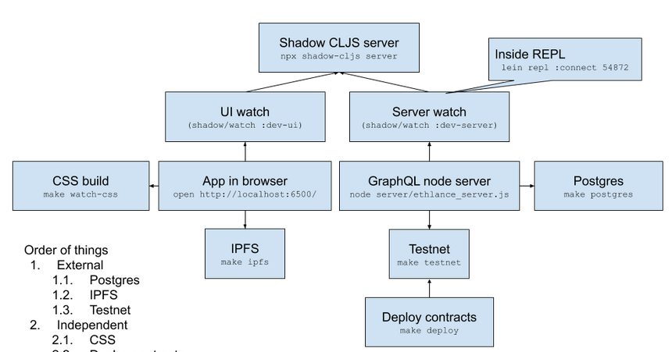
Cases
ethlance
https://github.com/district0x/ethlance

Slide 24
Ansible & TerraForm
TerraForm:
Terraform is a tool for building, changing, and versioning infrastructure safely and efficiently. Terraform can manage existing and popular service providers as well as custom in-house solutions
Example:
https://github.com/mlabouardy/terraform-aws-labs/tree/master/wordpress
User Data
https://www.bogotobogo.com/DevOps/Terraform/Terraform-terraform-userdata.php

Slide 25
Ansible & TerraForm
Ansible
Example:
https://github.com/paralect/ansible-node-sample
one name one command

